Slide 1
Part I: Tries and Patricia Tries

Slide 2
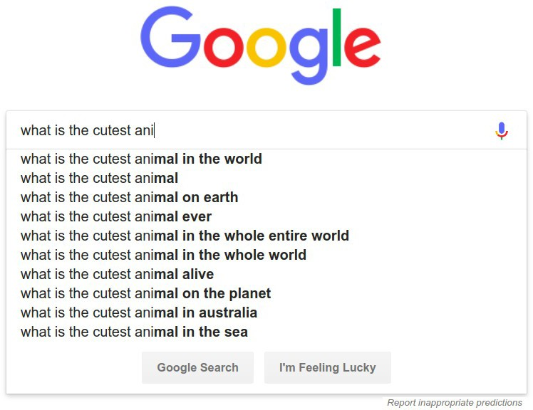
How is this done so quickly?

Slide 3
A Naive Solution

Slide 4
a | n | t
a | n | t | e
a | n | t | e | a | t | e | r
a | n | t | e
a | n | t | e | l | o | p | e
a | n | t | i | q | u | e
We’re spending a lot of time scanning shared prefixes. Is there a way to avoid this?

Slide 5
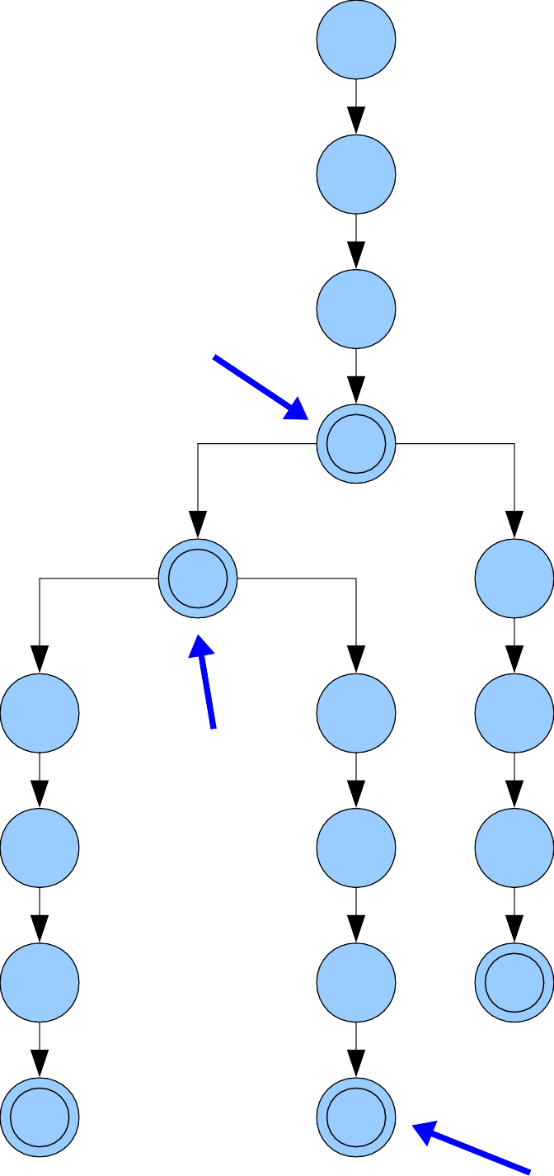
ant ante
anteater antelope antique
This data structure is called a trie. It comes from the word retrieval.
It is not pronounced like
“retrieval.”
a
n
ant
t
e
i
a
l
q
t
ante _{o}
u
e
p
e
antique
r
e
anteater
antelope

Slide 6
ant ante
anteater antelope antique
Each edge is labeled with a character.
Some nodes are marked as representing words.
By convention, children are stored in sorted order.
A preorder traversal of the trie prints all words in sorted order.
a
n
ant
t
e
i
a
l
q
t
ante _{o}
u
e
p
e
antique
r
e
anteater
antelope

Slide 7
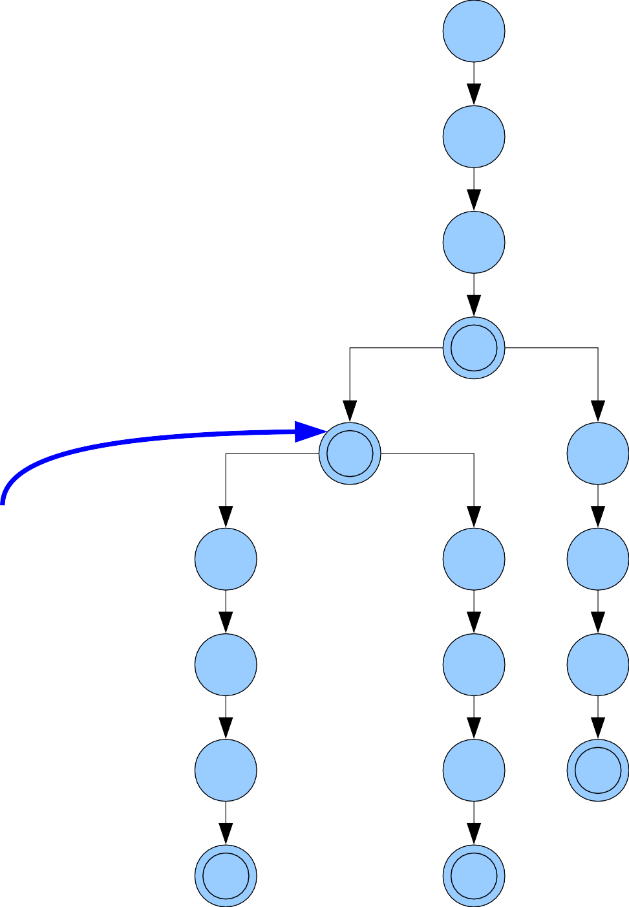
ant ante
anteater antelope antique
a | n | t | e
a
n
t
e
i
a
l
q
Now, do a DFS to find all words rooted here.
t
o u
e
p
e
r
e

Slide 8
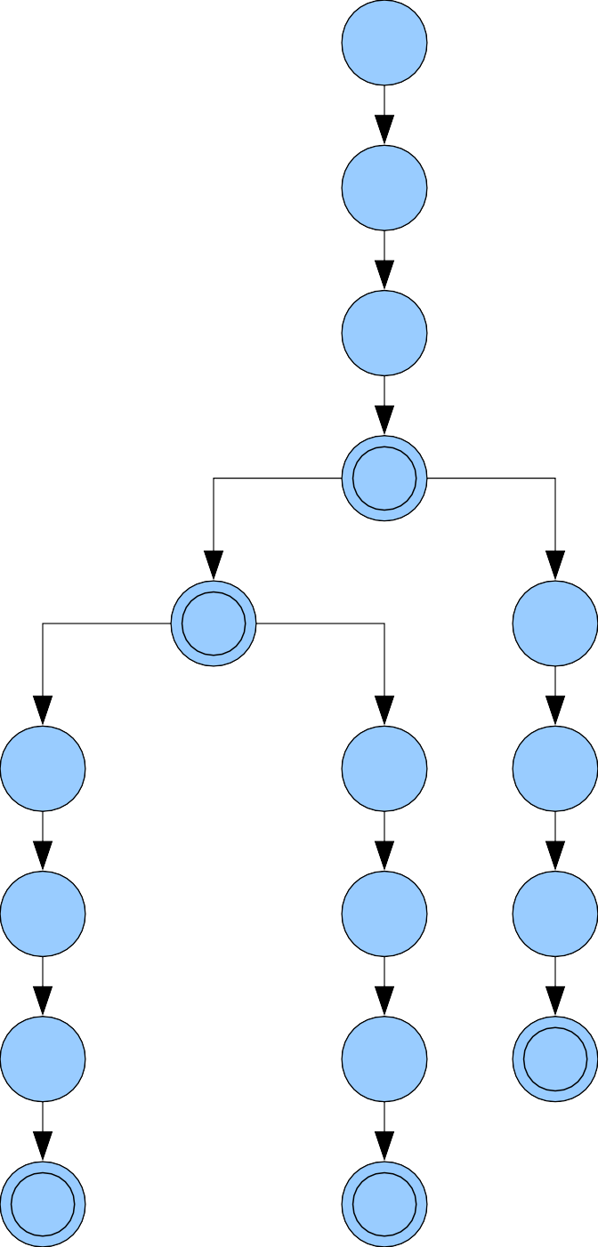
ant ante
anteater antelope antique
a | n | t | w
a
n
t
e
i
We fell off the trie.
There are no matches!
a
l
q
t
o u
e
p
e
r
e

Slide 9
ant ante
anteater antelope antique
a
n
t
e
i
a
l
q
t
o u
e
p
e
r
e

Slide 10
ant$ ante$ anteater$ antelope$ antique$
a
n
t
e
i
a
l
q
t
o u
e
p
e
r
e

Slide 11
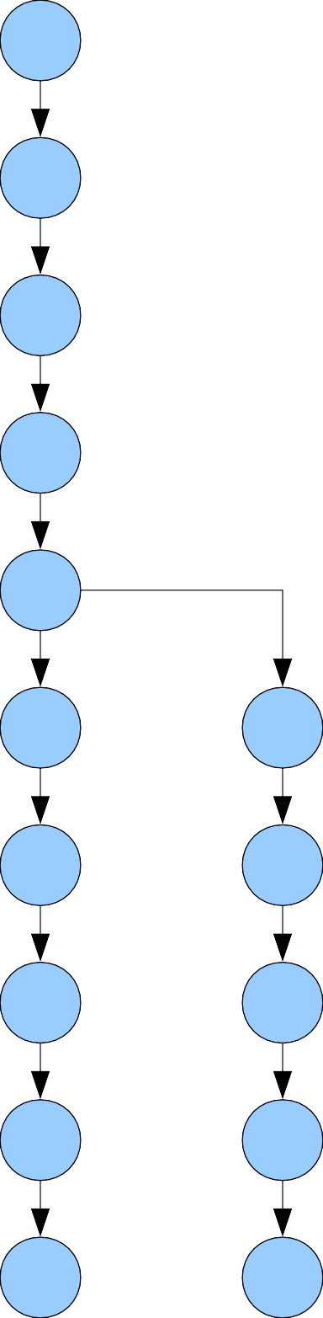
ant$ ante$ anteater$ antelope$ antique$
a
n
t
$
e
i
$
a
l
q
t
o
u
The $ symbol is called the sentinel or end- marker. It’s a special character that can only appear at the ends of words. (Think “null terminator,” Theoryland edition.)
e
p
e
r
e
$
$
$

Slide 12
ant$ ante$ anteater$ antelope$ antique$
a
n
t
$
e
i
$
a
l
q
t
o
u
By convention, the sentinel $ precedes all other characters.
(It really is like a null terminator!)
e
p
e
r
e
$
$
$

Slide 13
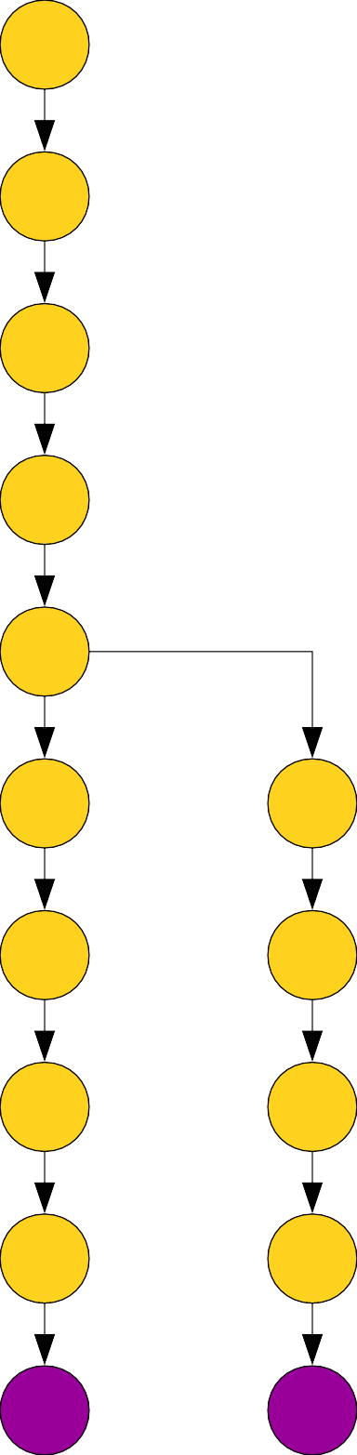
ant$ ante$ anteater$ antelope$ antique$
a
n
t
$
e
i
$
a
l
q
t
o
u
Nodes now fall into one of two classes:
Leaf nodes correspond to words in the trie.
Internal nodes correspond to routing structure.
e
p
e
r
e
$
$
$

Slide 14
ant$ ante$ anteater$ antelope$ antique$
a
n
t
$
e
i
$
a
l
q
t
o
u
A node is a silly node if it is a non-root node that only has one child.
e
p
e
A Patricia trie is a trie where silly nodes are merged into their
r
e
$
$
$
parents.

Slide 15
ant$ ante$ anteater$ antelope$ antique$
a n t
$
e
$
i q u e
$
A node is a silly node if it is a non-root node that only has one child.
a t e r
$
l
o
p e
$
A Patricia trie is a trie where silly nodes are merged into their
parents.

Slide 16
ant$ ante$ anteater$ antelope$ antique$
a n t
$
e
i q u e
$
$
a t e r
$
l
o
p e
$
A node is a silly node if it is a non-root node that only has one child.
A Patricia trie is a trie where silly nodes are merged into their parents.

Slide 17
Patricia Tries
●
Theorem: The number of nodes in a Patricia trie with k words is always O(k), regardless of what those words are.
a n t
$
e
i q u e
$
$
a t e r
$
l
o
p e
$

Slide 18
Patricia Tries
●
Theorem: The number of nodes in a Patricia trie with k words is always O(k), regardless of what those words are.
There are k
leaves, one
per word in the trie.

Slide 19
Patricia Tries
●
Theorem: The number of nodes in a Patricia trie with k words is always O(k), regardless of what those words are.
Think of this as a forest of k different trees.

Slide 20
Patricia Tries
Adding an internal node merges two or more trees together, decreasing the Number of trees by at least one.
●
Theorem: The number of nodes in a Patricia trie with k words is always O(k), regardless of what those words are.
$
a t e r
$
l
o
p e
$

Slide 21
Patricia Tries
●
Theorem: The number of nodes in a Patricia trie with k words is always O(k), regardless of what those words are.
a n t
Adding the root might not decrease the
number of trees, but there’s only one root.
$
e
i q u e
$
$
a t e r
$
l
o
p e
$

Slide 22
Patricia Tries
●
Theorem: The number of nodes in a Patricia trie with k words is always O(k), regardless of what those words are.
a n t
●
Proof Sketch: There are k leaves, one per word. Remove all internal nodes, leaving a forest of k trees.
Add the internal nodes back one at a time. Each addition (except possibly root) decreases the number of trees in the forest by at least one, since each (non-root) internal node has at least two children. This means there are at most k internal nodes, for a total of O(k) nodes. ■
$
e
i q u e
$
$
a t e r
$
l
o
p e
$

Slide 23
Patricia Tries
●
Claim: If each leaf in a Patricia trie is annotated with the index of the word it comes from, all strings starting with a given prefix can be found in time O(n + z), where n is the length of that prefix and z is the number of matches.
Question: How is this possible?
a n t
$
e
i q u e
$
1
$
a t e r
$
l
2
o
p e
$
5
3 4
●

Slide 24
Patricia Tries
Use a two-phase search algorithm!
(Character-aware) Read the prefix to search for, matching characters as you walk down the Patricia trie.
●
a n t
●
$
e
i q u e
$
Time required: O(n), since we have to read all the characters of the prefix.
(Character-blind) If you didn’t walk off the trie, do a DFS below your current point to find all leaves, ignoring the strings on the edges.
●
1
$
a t e r
$
●
l
2
o
p e
$
5
●
Time required: O(z). If there are z matches, there are z leaves to explore. As we saw earlier, in a Patricia trie, a subtree with z leaves has O(z) total nodes.
3 4

Slide 25
The Story So Far
●
Adopting our notation from RMQ, a Patricia trie gives an
⟨O(m), O(n + z)⟩
solution to prefix matching.
Those runtimes hide the effect of the alphabet size; take some time to evaluate those tradeoffs!
a n t
$
e
i q u e
$
1
$
a t e r
$
l
2
o
●
p e
$
5
3 4

Slide 26
Representing Tries
●
Each trie node needs to store pointers to its children.
There are many different data structures we could use to store these pointers.
For today, we'll assume we have an array of |Σ| pointers, one per possible child.
You'll explore variants on this strategy in the problem set.
●
a
c
t
●
●

Slide 27
Representing Tries
●
Each trie node needs to store pointers to its children.
There are many different data structures we could use to store these pointers.
For today, we'll assume we have an array of |Σ| pointers, one per possible child.
You'll explore variants on this strategy in the problem set.
●
●
●

Slide 28
Building a Trie
●
Claim: Given a set of strings P₁, …, Pₖ of total length n, it's possible to build a trie for those strings in time Θ(n).
a | t | e

Slide 29
Building a Trie
●
Claim: Given a set of strings P₁, …, Pₖ of total length n, it's possible to build a trie for those strings in time Θ(n).
a | t | e

Slide 30
Building a Trie
●
Claim: Given a set of strings P₁, …, Pₖ of total length n, it's possible to build a trie for those strings in time Θ(n).
a | t | e
a

Slide 31
Building a Trie
●
Claim: Given a set of strings P₁, …, Pₖ of total length n, it's possible to build a trie for those strings in time Θ(n).
a | t | e
a
t

Slide 32
Building a Trie
●
Claim: Given a set of strings P₁, …, Pₖ of total length n, it's possible to build a trie for those strings in time Θ(n).
a | t | e
a
t
e

Slide 33
Building a Trie
●
Claim: Given a set of strings P₁, …, Pₖ of total length n, it's possible to build a trie for those strings in time Θ(n).
a | t | e
a
t
e

Slide 34
Building a Trie
●
Claim: Given a set of strings P₁, …, Pₖ of total length n, it's possible to build a trie for those strings in time Θ(n).
a | t | e
a
t
e

Slide 35
Building a Trie
●
Claim: Given a set of strings P₁, …, Pₖ of total length n, it's possible to build a trie for those strings in time Θ(n).
a | t | e
a
t
e
a
n

Slide 36
Building a Trie
●
Claim: Given a set of strings P₁, …, Pₖ of total length n, it's possible to build a trie for those strings in time Θ(n).
a | t | e
a
t
e
a
n

Slide 37
Building a Trie
●
Claim: Given a set of strings P₁, …, Pₖ of total length n, it's possible to build a trie for those strings in time Θ(n).
a | t | e
a
t
e
a
n

Slide 38
Building a Trie
●
Claim: Given a set of strings P₁, …, Pₖ of total length n, it's possible to build a trie for those strings in time Θ(n).
a | t | e
a
t
e
a
n
n

Slide 39
Building a Trie
●
Claim: Given a set of strings P₁, …, Pₖ of total length n, it's possible to build a trie for those strings in time Θ(n).
a | t | e
a
t
e
a
n
n

Slide 40
Building a Trie
●
Claim: Given a set of strings P₁, …, Pₖ of total length n, it's possible to build a trie for those strings in time Θ(n).
a | t | e
a
t
e
a
n
n
a
t

Slide 41
Building a Trie
●
Claim: Given a set of strings P₁, …, Pₖ of total length n, it's possible to build a trie for those strings in time Θ(n).
a | t | e
a
t
e
a
n
n
a
t

Slide 42
Building a Trie
●
Claim: Given a set of strings P₁, …, Pₖ of total length n, it's possible to build a trie for those strings in time Θ(n).
a | t | e
a
t
e
a
n
n
a
t

Slide 43
Building a Trie
●
Claim: Given a set of strings P₁, …, Pₖ of total length n, it's possible to build a trie for those strings in time Θ(n).
a | t | e
a
t
e
a
n
n
a
t

Slide 44
Building a Trie
●
Claim: Given a set of strings P₁, …, Pₖ of total length n, it's possible to build a trie for those strings in time Θ(n).
a | t | e
a
t
e
a
n
n
a
t

Slide 45
Building a Trie
●
Claim: Given a set of strings P₁, …, Pₖ of total length n, it's possible to build a trie for those strings in time Θ(n).
a | t | e
a
t
e
a
n
n
a
t

Slide 46
Building a Trie
●
Claim: Given a set of strings P₁, …, Pₖ of total length n, it's possible to build a trie for those strings in time Θ(n).
a | t | e
a
t
e
a
n
n
a
t
b
e

Slide 47
Building a Trie
●
Claim: Given a set of strings P₁, …, Pₖ of total length n, it's possible to build a trie for those strings in time Θ(n).
a | t | e
a
t
e
a
n
n
a
t
b
e

Slide 48
Building a Trie
●
Claim: Given a set of strings P₁, …, Pₖ of total length n, it's possible to build a trie for those strings in time Θ(n).
a | t | e
a
t
e
a
n
n
a
t
b
b
e

Slide 49
Building a Trie
●
Claim: Given a set of strings P₁, …, Pₖ of total length n, it's possible to build a trie for those strings in time Θ(n).
a | t | e
a
t
e
a
n
n
a
t
b
e
b
e

Slide 50
Building a Trie
●
Claim: Given a set of strings P₁, …, Pₖ of total length n, it's possible to build a trie for those strings in time Θ(n).
a | t | e
a
t
e
a
n
n
a
t
b
e
b
e

Slide 51
Building a Trie
●
Claim: Given a set of strings P₁, …, Pₖ of total length n, it's possible to build a trie for those strings in time Θ(n).
a | t | e
a
t
e
a
n
n
a
t
b
e
b
e

Slide 52
Our Strategies
●
We'll say that a solution to multi-string matching runs in time
⟨p(m, n), q(m, n)⟩ if the preprocessing time is
p(m, n) and the matching time is q(m, n).
We now have two approaches:
●
No preprocessing: ⟨O(1), O(mn)⟩. Trie searching: ⟨O(n), O(mL_{max})⟩.
●
●
●
Can we do better?

Slide 53
a
g
b
e
b
t
Pattern Strings
a | b
a | b | o | u | t
a | t
a | t | e
b | e
b | e | d
e | d | g | e
g | e | t
e
d
e
o
e
d
g
t
u
e
t
a | b | e | d | g | e | t

Slide 54
a
g
b
e
b
t
Pattern Strings
a | b
a | b | o | u | t
a | t
a | t | e
b | e
b | e | d
e | d | g | e
g | e | t
e
d
e
o
e
d
g
t
u
e
t
a | b | e | d | g | e | t

Slide 55
a
g
b
e
b
t
Pattern Strings
a | b
a | b | o | u | t
a | t
a | t | e
b | e
b | e | d
e | d | g | e
g | e | t
e
d
e
o
e
d
g
t
u
e
t
a | b | e | d | g | e | t

Slide 56
a
g
b
e
b
t
Pattern Strings
a | b
a | b | o | u | t
a | t
a | t | e
b | e
b | e | d
e | d | g | e
g | e | t
e
d
e
o
e
d
g
t
u
e
t
a | b | e | d | g | e | t

Slide 57
a
g
b
e
b
t
Pattern Strings
a | b
a | b | o | u | t
a | t
a | t | e
b | e
b | e | d
e | d | g | e
g | e | t
e
d
e
o
e
d
g
t
u
e
t
a | b | e | d | g | e | t

Slide 58
a
g
b
e
b
t
Pattern Strings
a | b
a | b | o | u | t
a | t
a | t | e
b | e
b | e | d
e | d | g | e
g | e | t
e
d
e
o
e
d
g
t
u
e
t
a | b | e | d | g | e | t

Slide 59
a
g
b
e
b
t
Pattern Strings
a | b
a | b | o | u | t
a | t
a | t | e
b | e
b | e | d
e | d | g | e
g | e | t
e
d
e
o
e
d
g
t
u
e
t
a | b | e | d | g | e | t

Slide 60
a
g
b
e
b
t
Pattern Strings
a | b
a | b | o | u | t
a | t
a | t | e
b | e
b | e | d
e | d | g | e
g | e | t
e
d
e
o
e
d
g
t
u
e
t
a | b | e | d | g | e | t

Slide 61
a
g
b
e
b
t
Pattern Strings
a | b
a | b | o | u | t
a | t
a | t | e
b | e
b | e | d
e | d | g | e
g | e | t
e
d
e
o
e
d
g
t
u
e
t
a | b | e | d | g | e | t

Slide 62
a
g
b
e
b
t
Pattern Strings
a | b
a | b | o | u | t
a | t
a | t | e
b | e
b | e | d
e | d | g | e
g | e | t
e
d
e
o
e
d
g
t
u
e
t
a | b | e | d | g | e | t

Slide 63
a
g
b
e
b
t
Pattern Strings
a | b
a | b | o | u | t
a | t
a | t | e
b | e
b | e | d
e | d | g | e
g | e | t
e
d
e
o
e
d
g
t
u
e
t
a | b | e | d | g | e | t

Slide 64
a
g
b
e
b
t
Pattern Strings
a | b
a | b | o | u | t
a | t
a | t | e
b | e
b | e | d
e | d | g | e
g | e | t
e
d
e
o
e
d
g
t
u
e
t
a | b | e | d | g | e | t

Slide 65
a
g
b
e
b
t
Pattern Strings
a | b
a | b | o | u | t
a | t
a | t | e
b | e
b | e | d
e | d | g | e
g | e | t
e
d
e
o
e
d
g
t
u
e
t
a | b | e | d | g | e | t

Slide 66
a
g
b
e
b
t
Pattern Strings
a | b
a | b | o | u | t
a | t
a | t | e
b | e
b | e | d
e | d | g | e
g | e | t
e
d
e
o
e
d
g
t
u
e
t
a | b | e | d | g | e | t

Slide 67
a
g
b
e
b
t
Pattern Strings
a | b
a | b | o | u | t
a | t
a | t | e
b | e
b | e | d
e | d | g | e
g | e | t
e
d
e
o
e
d
g
t
u
e
t
a | b | e | d | g | e | t

Slide 68
a
g
b
e
b
t
Pattern Strings
a | b
a | b | o | u | t
a | t
a | t | e
b | e
b | e | d
e | d | g | e
g | e | t
e
d
e
o
e
d
g
t
u
e
t
a | b | e | d | g | e | t

